Slide 1
Exoplanet Detection -
Measuring Mass, Radius, and Density
February 2024
Seth Ketchem, Raihan Malik,
and Mitchell Weber
Group 8

Slide 2
Motivation
Analyze an exoplanet’s detection data to measure its radius, mass, and density
How much uncertainty is there?
Compare with other data sets
Is it consistent?

Slide 3

HD 189733 b
Our planet
Well-known exoplanet
Lots of transit data!
In a binary star system
Rains molten glass

Slide 4
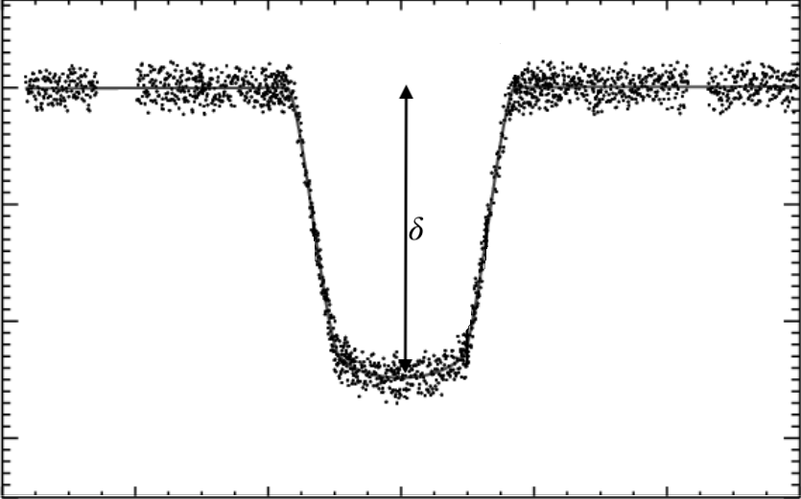
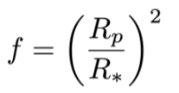
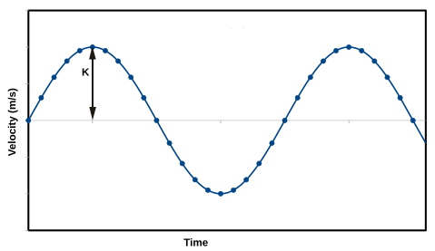


Transit Data
RV Data
Combination
Methods
Can find the radius of the planet
Can find the mass of the planet
Can find the density of the planet

Slide 5
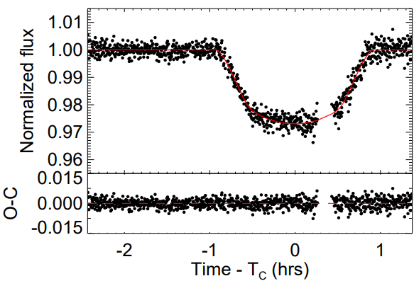
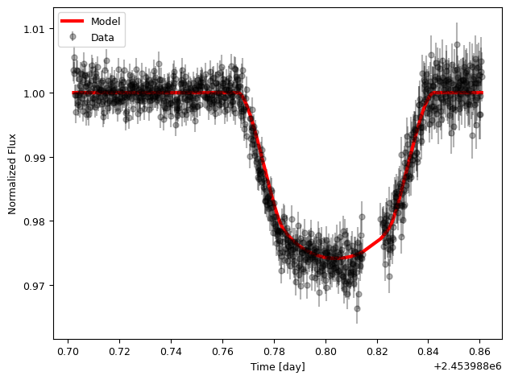
Plots
EXOFAST
PYTHON

Slide 6
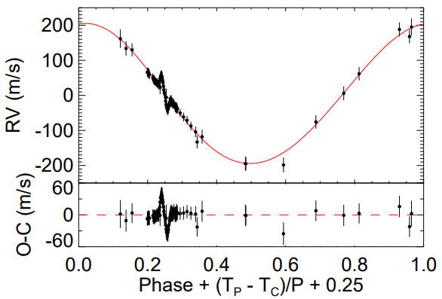
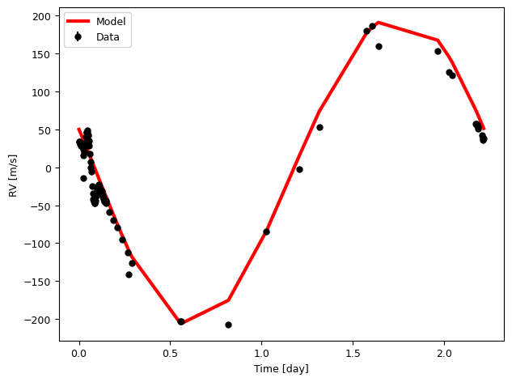
Plots
EXOFAST
PYTHON

Slide 7
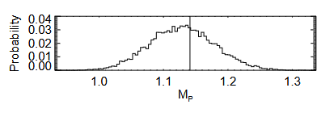
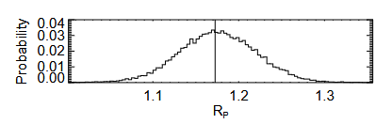
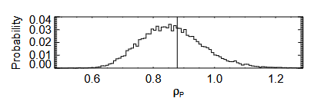
Uncertainty
Methods - Uncertainty
Raw data comes with error
We get a value for K and f with that data
We use a MCMC simulation to get a spread of values for K and f
Convert these into mass and radius
Now we have a spread of values for mass and radius
This gives us our uncertainty

Slide 8
Radius
1.1771 ± 0.0447 R_{J}
Mass
1.1294 ± 0.0506 M_{J}
Density
0.86163 ± 0.1087 g/cm³
Results

Slide 9
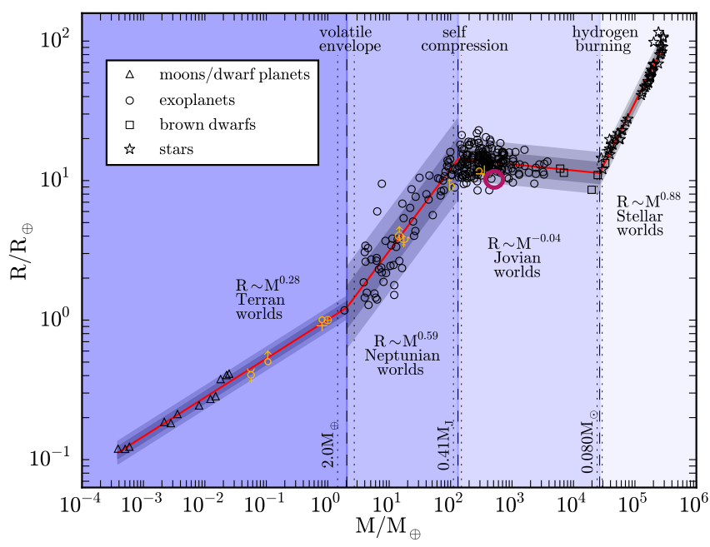
How does this compare?
Plots
Consistent with:
other Jovian worlds
the M-R relation

Slide 10
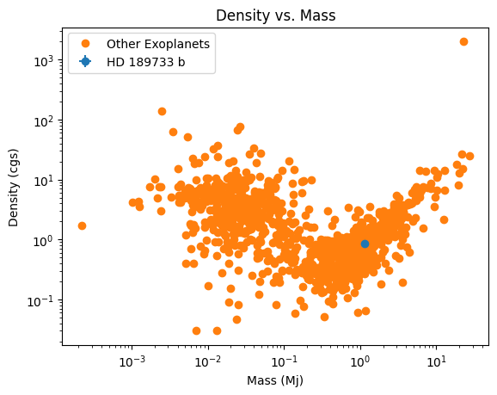
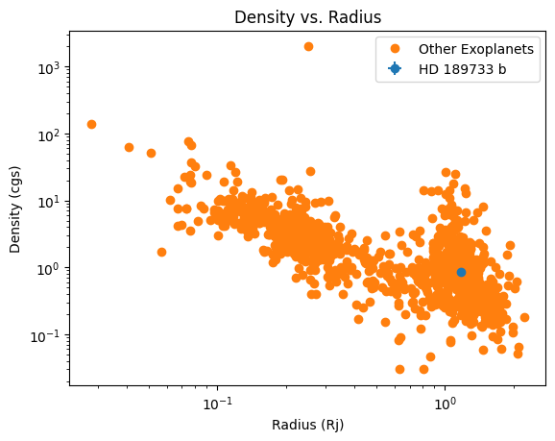
Plots

Slide 11
Conclusion
HD 189733 b is a Jupiter-like planet with a lower density
Our data has some uncertainty, but is still statistically sound
Our measurements align with existing models

Slide 12
Questions?
Division of work
Coding - Raihan Malik
EXOFAST - Raihan Malik, Seth Ketchem
Paper - Mitchell Weber
Presentation - Seth Ketchem

